Slide 1
EKITI STATE UNIVERSITY
ADO-EKITI
FACULTY OF ARTS
POSITION OF FACULTY OF ARTS ON ACADEMIC PROGRAMMES VIABILITY, ACCOMMODATION, CLASSROOM, ACCREDITATION, EXAMINATIONS, RESULTS PROCESSING, CHALLENGES AND WAY FORWARD TO PROPEL EKSU TO WORLD CLASS UNIVERSITY
PRESENTED BY:
PROF. S. O. KOLAWOLE
DEAN OF ARTS

Slide 2
INTRODUCTION
Arts is one of the Faculties that started the University in 1982. Hence, the Faculty is as old as the University itself.
Two Departments (Department of English and Literary Studies & History (now known as History and International Studies) began the Faculty in 1982.
The Faculty now has seven Departments.

Slide 3
THE SEVEN DEPARTMENTS ARE:
Department of English and Literary Studies
Department of French
Department of History and International Studies
Department of Linguistics and Nigerian Languages
Department of Philosophy
Department of Religious Studies
Department of Theatre and Media Arts

Slide 4
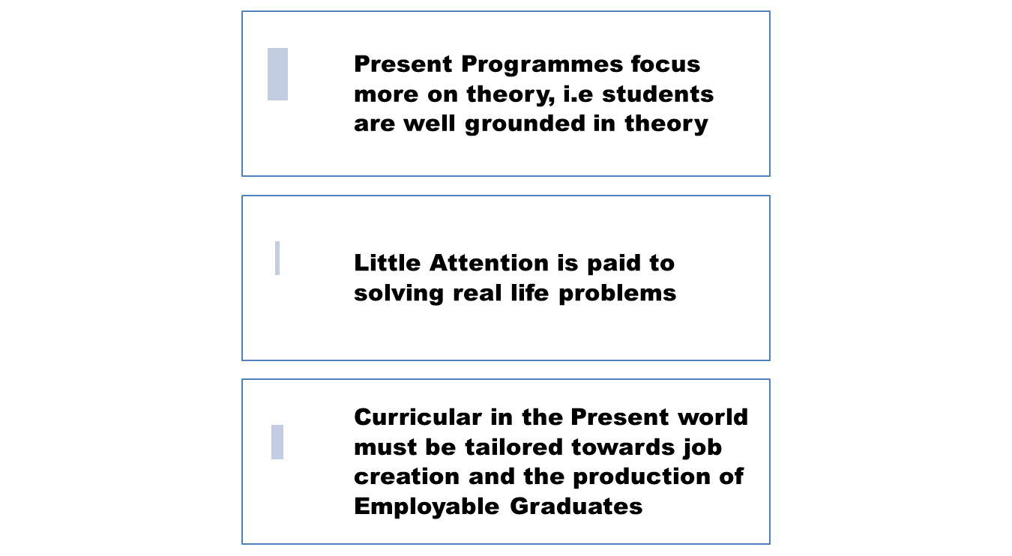
REVISION OF EXISTING PROGRAMMES

Slide 5
Establishing New Programmes
Viable Programmes that will Expand the scope of activities in the University
Programmes that will attract prospective students
Programmes that will produce employable graduates
That will make graduates employers of labour such as:
  Mass communication
  Translation Studies
  Music and Cultural Studies
  Communication Arts

Slide 6
STAFFING
Recruitment of qualified teaching and non teaching staff
Organise orientation programmes to sensitize new staff to the understanding of the ethics of the job
Proper mentoring of junior academic staff
Training and Retraining of staff

Slide 7
EXAMINATION
Provision of big halls for large classes, there is dearth of classroom facilities
Proper monitoring of invigilators
Provision of electricity, computer, printer and photocopier
Prompt sanctioning of culprits of examination malpractices

Slide 8
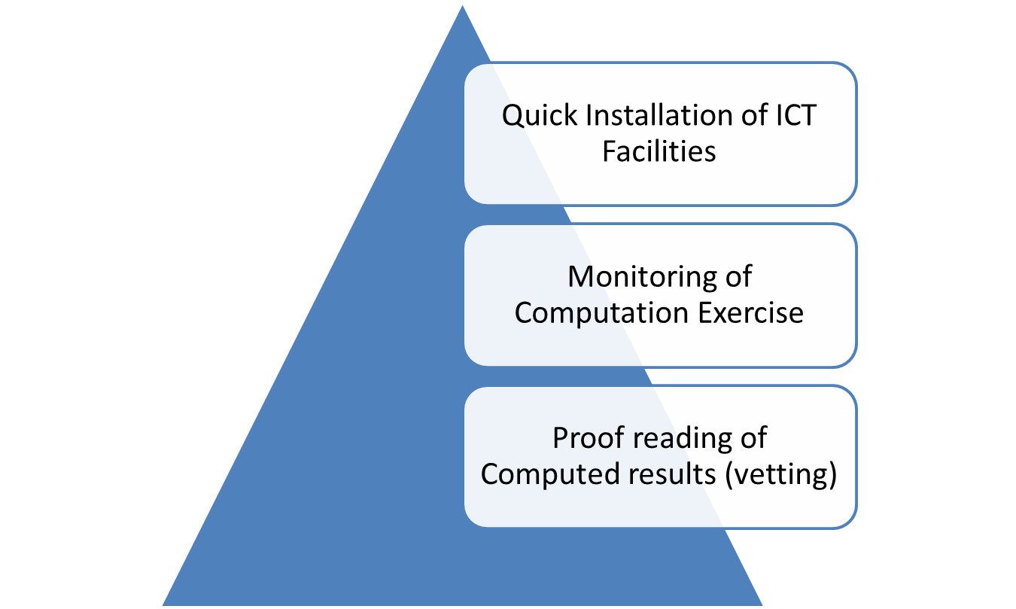
COMPUTATION

Slide 9
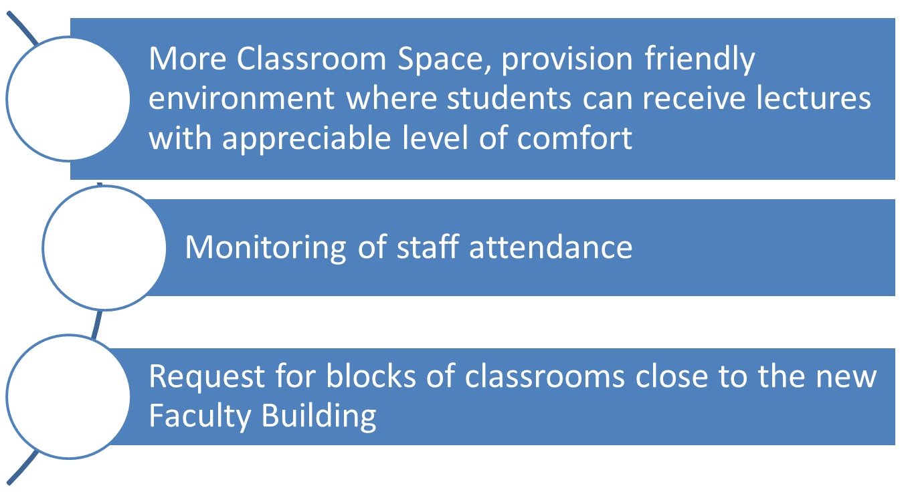
Classroom and Office Facilities

Slide 10
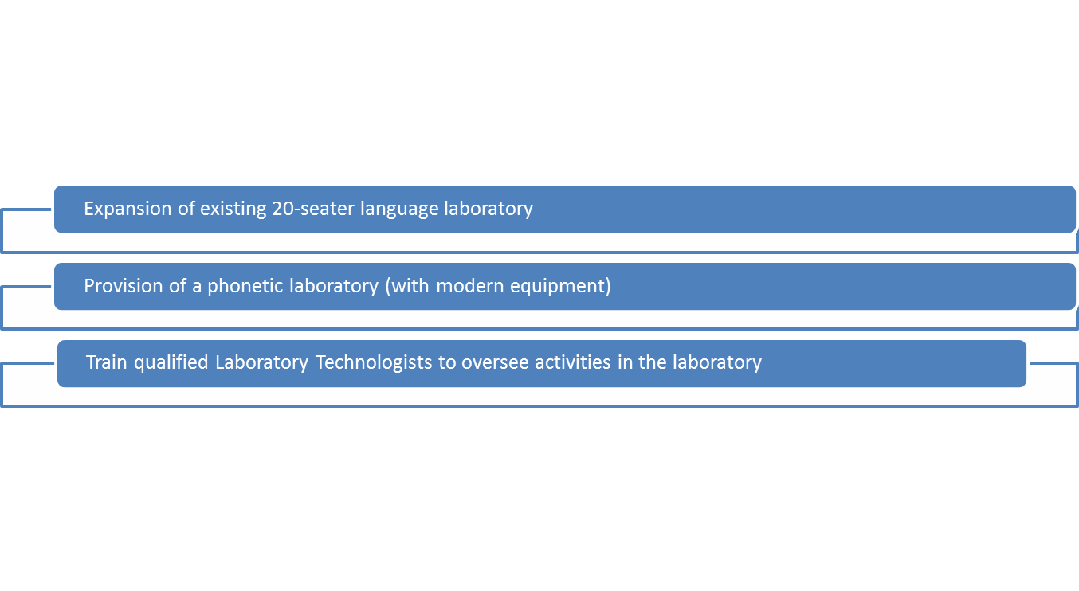
LANGUAGE AND PHONETIC LABORATORY

Slide 11
LANGUAGE FOR SPECIFIC PURPOSES (LSP) TO TAKE CARE OF THE FOLLOWING
Basic Interpersonal Communication Skills (BICS) for travellers to non-English speaking countries
Speech writing, editing, delivery
Postgraduate thesis editing/proof reading
Book editing/proof reading
General/Audio-visual Translation
Community Interpreting
African/Yoruba Cultural Practices
Diploma in Linguistics
Diploma in French
Diploma in Theatre and Media Arts

Slide 12
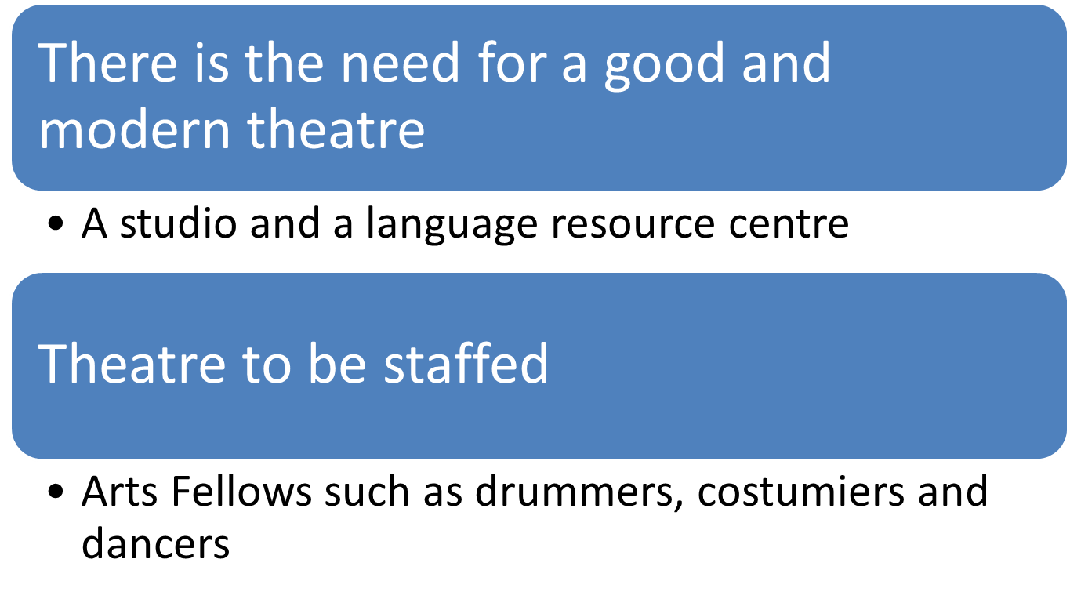
THEATRE HALL AND STUDIO

Slide 13
FACULTY LIBRARY
A well stocked Faculty Library is part of NUC and MAS

Slide 14
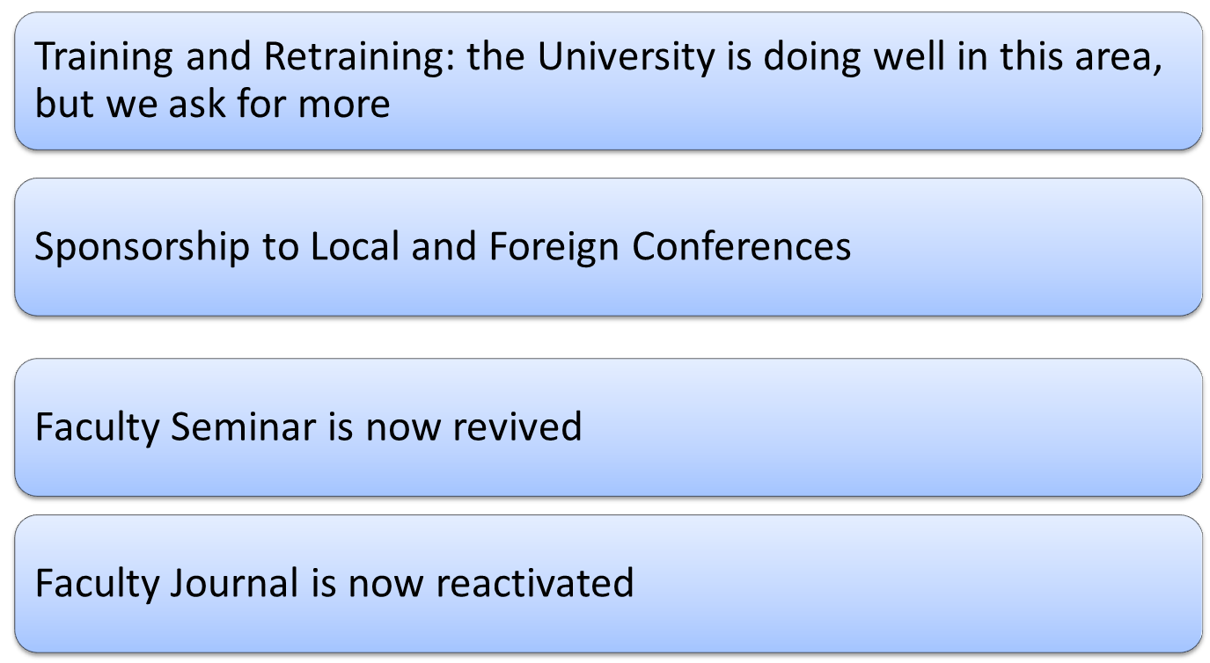
STAFF DEVELOPMENT

Slide 15
SUMMARY OF WAYS FORWARD
1. Establishment of new academic programmes to expand the scope of our activities and to attract prospective students
2. University Management to recruit more qualified and supporting staff.
3. University to put in place rules and regulations guiding the monitoring of junior academic staff for effective teaching and research.
4. Facilities in terms of personnel, units of computers, printers and photocopiers should be made available and culprits of examination misconduct should be investigated and punished accordingly.
5.

Slide 16
Proper and adequate documentation of academic records at three levels – Department, Faculty and University.
6. More efforts should be made to complete the Faculty building under construction.
7. Language Laboratory should be expanded and a phonetic language resource centre should be provided by the University.
8. Need to have a well stocked Library- requirement of NUC.
9. The University should sponsor more staff to both local and international conferences.
10 Establishment of Institute of Multidisciplinary studies to add to both IGR and Academic viability of the Faculty and University.

